Slide 1
Schwarz Gesundheit
TUM BUSINESS GAME HEILBRONN 2026 · SCHWARZ GROUP CASE
From a Simple Retailer to the Largest Health Ecosystem
Digital
In-store
Long-term vision
Team 9: Arina, Adam, Athish, Sakhobiddin
Notes:
Good morning. We are [team name], and today we want to show how Schwarz can move from point of sale to point of well-being.

Slide 2
Our presentation outline
AGENDA
01
02
03
Problem statement
Digital concepts
In-store concepts
The intention-action gap
Short to medium term
Short to medium term
04
05
06
Schwarz Gesundheit
Value and strategic fit
Business logic
Long-term vision
Why it works for Schwarz
Where to start and how it pays
Notes:
We start with the problem, then show our short- and medium-term solutions, digital and in-store, then our long-term vision, and finish with why it fits Schwarz and how it makes money.

Slide 3



People want to live healthier. Daily life gets in the way.
PROBLEM STATEMENT
INTENTION
The intention-action gap
ACTION
“I want to eat healthier.”
“…but I don’t manage it.”
too expensive · too complex · too lonely
Expensive
Complex
Lonely
Healthy food and personal health advice feel like a premium product.
Diets, apps and advice are fragmented and hard to fit into a busy week.
People try alone, without support, motivation or community.
Retail today sells the ingredients, then leaves customers alone with the execution.
Notes:
People want to live healthier, but they struggle in daily life. That is the intention-action gap. Healthy living feels expensive, it is complicated, and people try it alone. And retail is part of the problem: we sell the ingredients and then leave the customer alone. Schwarz is in people’s lives every week, but today only at the till.

Slide 4








One app from health goal to shopping basket
DIGITAL CONCEPT · LIDL.GESUND APP SECTION
Good morning,
Jonas
Today’s energy
1,420 of 2,700
kcal eaten
AI meal planning
Health profile
Meals tailored to your goals
BMI and daily calorie target
Tonight
Lentil curry
Nutrition per serving
Smart shopping list
520 kcal · €2.10 each
Calories, protein, carbs, fat
Ingredients matched to Lidl
Your bet: 3 of 5
Health Line by phone
Future You avatar
veg days this week
Order by voice, no app needed
See yourself in 6 to 12 months
Bet on yourself
FoodMatch
Add to shopping basket
Pledge €10, win food credit
Meet, cook and eat together
Notes:
This is our digital concept for the short and medium term: one app that takes a customer from a health goal to a ready shopping basket. It plans meals with AI, knows your calorie target if you want it to, shows the nutrition of every recipe, and turns the plan into a Lidl shopping list in one tap. Two features make it stick: Future You, which shows where your current basket is taking you, and Bet on yourself, which puts a small stake on your own goal. Health Line brings the same service to people without a smartphone, and FoodMatch connects people to cook and eat together. Everything is opt-in and GDPR-first.

Slide 5


Goal to basket in three taps
HOW IT WORKS
1 · Your profile
2 · Your week
3 · Your Lidl list
Height
Weight
M
T
W
T
F
S
S
3 dinners for 2 people
178 cm
76 kg
Red lentils
€1.29
Tonight
Age
Activity
Lentil curry with rice
Basmati rice
€1.99
24
Medium
520 kcal · €2.10 each
Coconut milk
€0.99
P 24g
C 74g
F 14g
Spinach
€1.49
BMI
24.0 · normal
Oats
€0.79
Maintain
Lose
Gain
Oat bowl
410 kcal
Total
€6.55
2,700 kcal
Veggie wrap
580 kcal
per day to maintain
Add to shopping list
Illustrative mockup. Values and prices are examples.
Notes:
Here is the flow in three screens. First, the customer can optionally enter height, weight, age and activity. The app shows the BMI and a daily calorie target for maintaining, losing or gaining weight. Second, AI builds a weekly meal plan, and every recipe shows calories and macros per serving. Third, the plan becomes a Lidl shopping list with real products and prices, sent straight to the Lidl app. Health advice turns directly into a basket.

Slide 6


See where your basket is taking you
FUTURE YOU
IN 12 MONTHS, SAME BASKET
IN 12 MONTHS, WITH SWAPS
Energy
Low
Energy
High
Sleep quality
Poor
Sleep quality
Good
Heart health
At risk
Heart health
Good
Fitness
Low
Fitness
Rising
Basket today: soft drinks, sweets, ready meals
With swaps: fruit, vegetables, whole grains
Illustrative. The avatar is opt-in and built from the user’s own photo and purchase history.
Notes:
Future You turns abstract health advice into something people can see. Based on the last three months of purchases, the app projects an avatar of you 6 to 12 months ahead. On the left: same basket, low energy, poor sleep. On the right: the same person with simple swaps. The point is motivation, not shame: the avatar is private, opt-in, and always shows the better path right next to it, with the swaps that get you there.

Slide 7
Put €10 on your own health goal
This month’s bet
BET ON YOURSELF
Half my basket is fruit and veg
Your stake
€10
1
Pick a goal
For example: half your basket is fruit and vegetables
Fruit and veg share
2
Stake €10 and shop as usual
46%
The Lidl app tracks every basket automatically
3
Settle at month end
Goal 50% · week 3 of 4
Either way, someone wins
On track
Goal reached
Goal missed
Make it and win €15 credit
€15 back
€10 to the Tafel
as fresh-food credit, co-funded by a health insurer
Your stake feeds families in need
Raise my stake
Notes:
Bet on yourself closes the intention-action gap with a commitment device from behavioral economics, the same idea behind Thaler’s Save More Tomorrow and the platform stickK. You pick a goal, stake €10, and shop as usual while the app tracks your baskets. Make it, and you get €15 back as fresh-food credit, with part of the reward co-funded by a health insurer partner. Miss it, and your €10 goes to the Tafel. Nobody loses: either you get healthier, or a family in need gets fed.

Slide 8


Digital health with zero screens
HEALTH LINE · POWERED BY AI FOR THE ELDERLY PEOPLE AND OTHERS
Call with Health Line · 2:14 min
“Same as last week, but less salt, please.”
Just call and talk
Order by phone in plain language
Healthy swaps
“Of course, Mrs. Weber. I swapped the salted crackers for unsalted ones and added fresh spinach.”
Less salt and sugar, same price
Remembers routines
Knows the usual basket
“Wonderful, thank you.”
Family safety net
Alerts family if orders stop (opt-in)
“Your order is ready on Thursday. See you then!”
Fits the “digital balance” megatrend
Notes:
Not everyone has a smartphone. Health Line lets older customers order simply by calling a voice assistant: “Same as last week, but less salt.” It suggests healthier swaps, remembers their routine, and, if they agree, alerts their family when they suddenly stop ordering. That is digital health with zero screens, which fits the digital balance megatrend in a surprising way.

Slide 9



From Point of Sale to Point of Well-Being
IN-STORE EXPERIENCE · SHORT TO MEDIUM TERM
1
2
3
Smart and personalized shopping
Healthy products and accessibility
Health and innovation stations
Goal-based shopping
Healthy own-brand line
Self-service health stations
Store routes by goal: high protein, budget or 15-minute meals
Health range, meal-prep kits and wellness sections
Weight, height and blood pressure, synced to LidlHealth
AI shopping assistant
Healthy Deals
Customer Health Lab
Recipes and automatic lists via LidlHealth
Weekly discounts on selected nutritious products
Shoppers vote on and co-create healthier products
Smart nutritional nudges
Healthier swaps on shelf labels, QR codes and receipts
Smart packaging
Measure
Sync
Plan
Quick recipes and health tips printed on the pack
Notes:
In the store, we personalise shopping around the customer’s goal: routes for high protein, budget or 15-minute meals, an AI assistant, and nudges on shelf labels and receipts. We make healthy products more accessible with a dedicated own-brand health line, weekly Healthy Deals and packaging that tells you what to cook. And we add health stations where customers can measure weight and blood pressure and sync it to LidlHealth, plus a Customer Health Lab where shoppers co-create the next healthy products.

Slide 10




Supermarkets as community health hubs
BEYOND SHOPPING
Daily 18:00
Weekly, free
Earn credits
Healthy Hour
Move with Lidl
Lidl Life Exchange
From food waste to community meals
Fitness for everyone
Healthy actions become rewards
Surplus fresh produce becomes free, supervised cooking sessions
Healthy eating, social contact and less waste in one
Yoga, fitness and wellbeing sessions with local instructors
Walking routes and outdoor zones starting at the store
Pay for groceries with healthy actions, not money
Grocery credits for walks, workouts and cooking classes
Funded by insurers, municipalities and employers
Core value: Schwarz stores become accessible neighbourhood health hubs that connect nutrition, activity, prevention and community.
Notes:
Beyond shopping, we turn stores into community health hubs. Healthy Hour turns surplus fresh produce into free, supervised community cooking. Move with Lidl offers free weekly fitness and walking routes that start at the store. And Lidl Life Exchange turns healthy actions into grocery credits, funded by insurers, municipalities and employers. Healthy living becomes affordable, social and rewarding.

Slide 11
"Walk 3,000 steps this week = earn €2 toward your groceries."

Slide 12





FoodMatch: swipe right on social wellbeing
FoodMatch
SOCIAL WELLBEING · INSIDE LIDLHEALTH
H
Helga, 72
Bakes whole-grain bread, loves Sunday walks
Match and connect
In-store social spaces
Nearby people, shared food tastes
Communal tables and dining areas
Baking
Walks
Cooking masterclasses
Community dining
Chefs, nutritionists, local cooks
Shared meals and themed dinners
Community dinner
Thu 18:30 · your Kaufland
Book in the app
Less loneliness
Events, matches and meetups
Real connections across ages
“More than shopping. A place to connect.”
For Schwarz: more visits, loyalty and foot traffic
Pass
Match
Notes:
FoodMatch is a Tinder-inspired feature inside LidlHealth that connects people through food. You match with people nearby who share your food tastes and interests, then meet at communal tables, cooking masterclasses or community dinners right inside Lidl and Kaufland stores. It reduces loneliness, brings generations together, and turns the supermarket into a social destination, which means more visits and stronger loyalty for Schwarz.

Slide 13







The neighbourhood health hub
LONG-TERM VISION · SCHWARZ GESUNDHEIT
Check-ups and care
Healthy production
Health stations, pharmacy, telemedicine
Own-brand health range made by Schwarz
Every Lidl and Kaufland becomes a place where people eat, move, meet and get checked.
Schwarz
Gesundheit
Cooking school
Social dining
One membership for food, health and community
Masterclasses and community kitchen
FoodMatch tables and shared meals
Co-funded by insurers’ prevention budgets
Built on the stores people already visit every week
Move and recover
Digital companion
Fitness classes, walks, recovery rooms
LidlHealth app and Health Line
Notes:
Our long-term vision is Schwarz Gesundheit: every Lidl and Kaufland becomes a neighbourhood health hub. Under one membership, customers get check-ups and care, a healthy own-brand range produced by Schwarz itself, a cooking school, social dining through FoodMatch, fitness and recovery, and a digital companion in LidlHealth and Health Line. Insurers co-fund it from their prevention budgets, because prevention is cheaper than treatment. Schwarz moves from selling food to being paid for health.

Slide 14
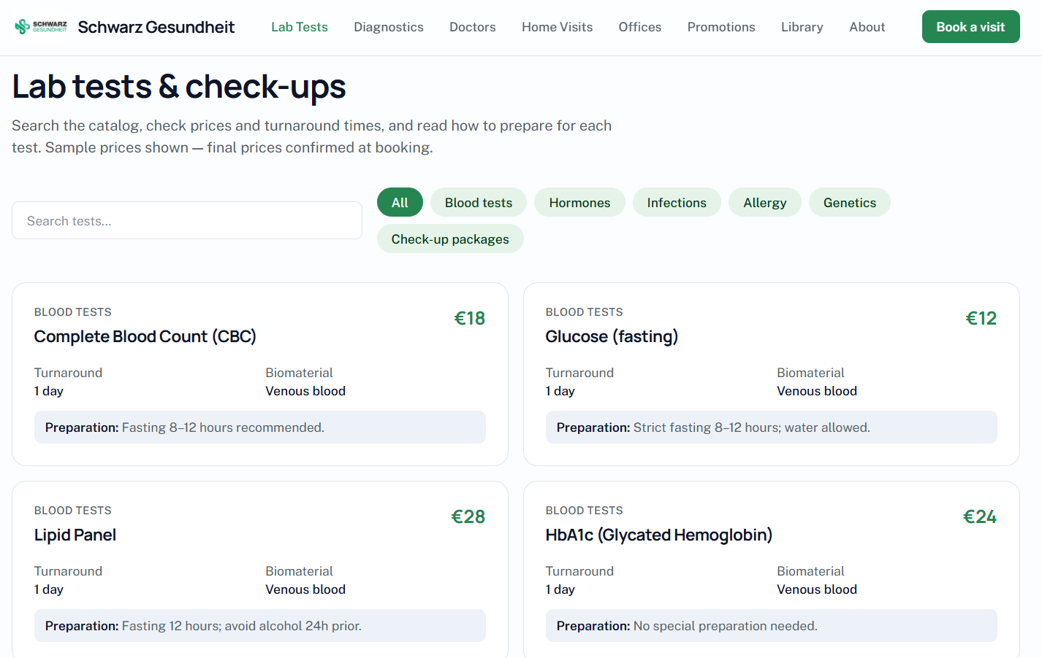
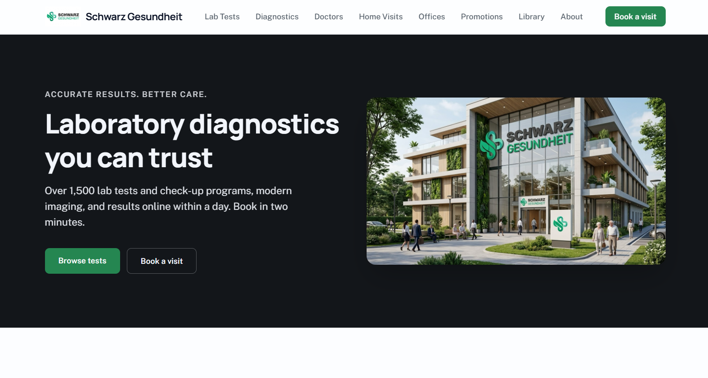
Schwarz Gesundheit

Slide 15
Schwarz Gesundheit

Slide 16
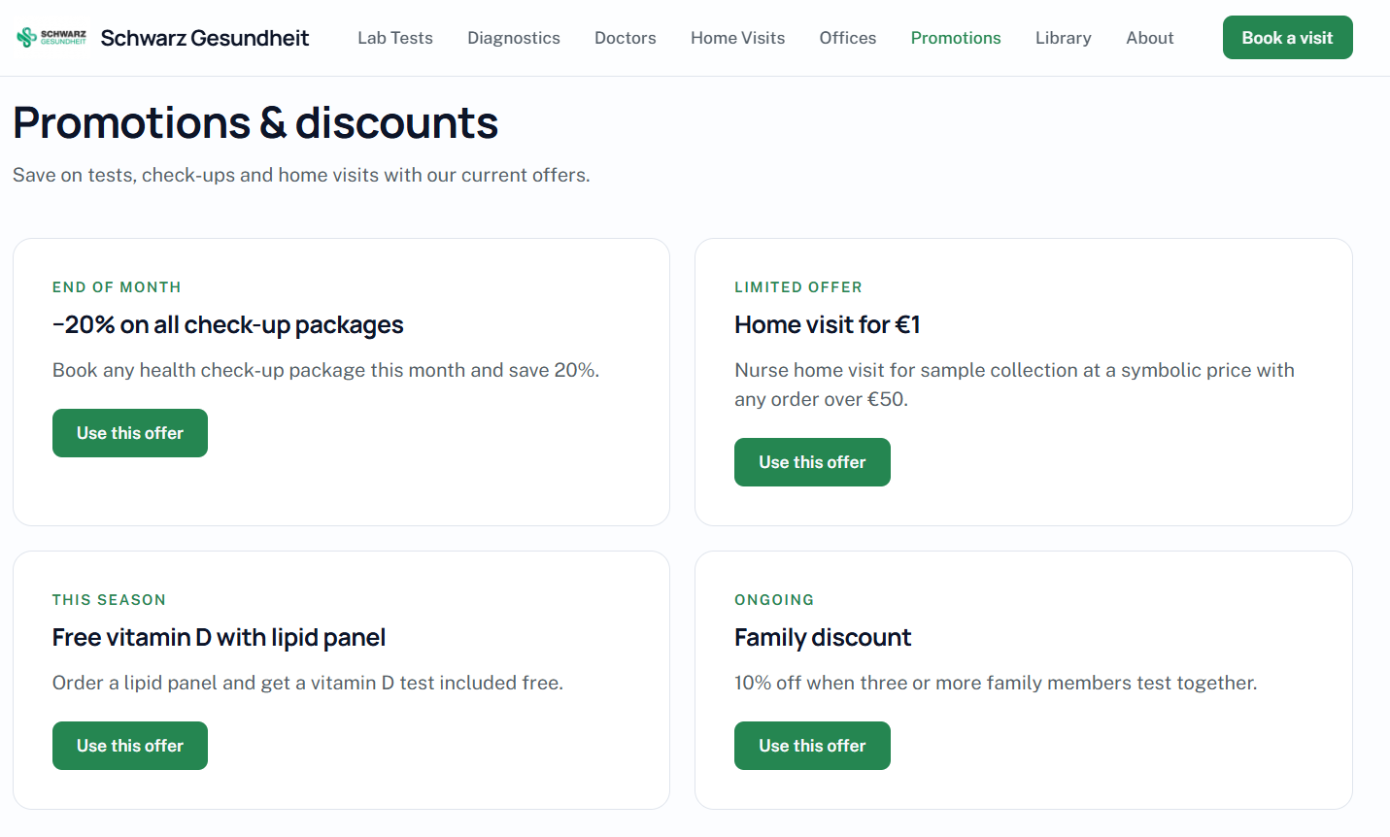
Schwarz Gesundheit

Slide 17
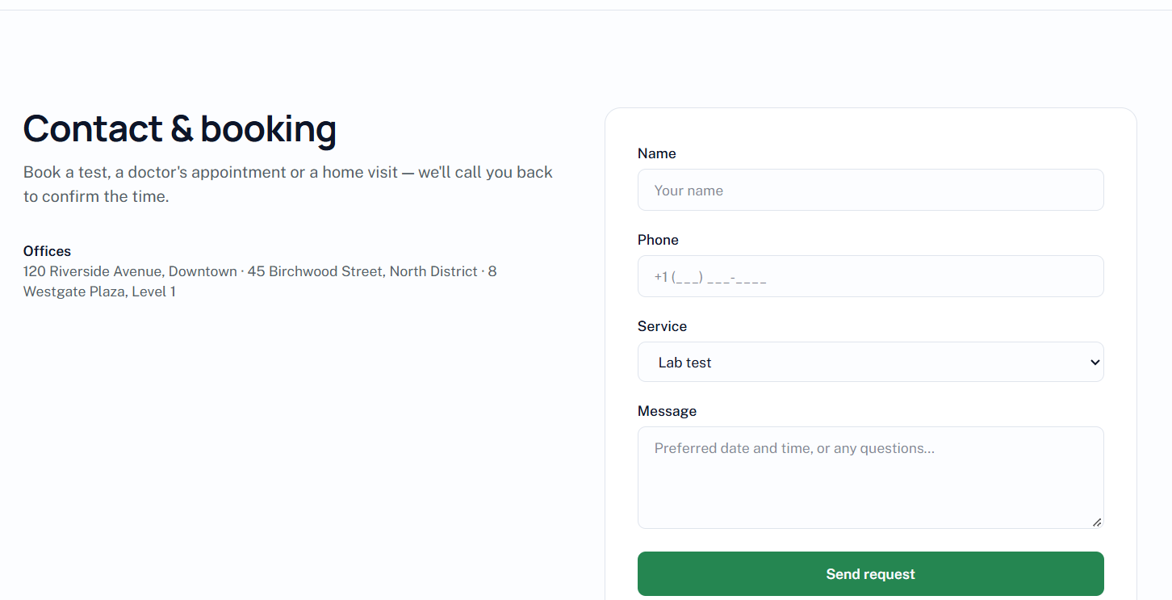
Schwarz Gesundheit

Slide 18

Healthy living: affordable, simple, social
VALUE PROPOSITION
CUSTOMER PAIN
OUR ANSWER
FOR SCHWARZ
Too expensive
Healthy Deals, price-neutral swaps, Life Exchange credits
More visits and bigger baskets
Shift to fresh and own-brand
New partner revenue
A brand people trust with health
Too complex
AI meal plans, smart lists, goal-based shopping, Health Line
Too lonely
FoodMatch, Healthy Hour, Move with Lidl
FOR SOCIETY
Prevention instead of treatment
Less food waste
Less loneliness, across all ages
No motivation
Future You, Bet on yourself, health stations
Notes:
ADAM Our value proposition answers the four reasons people fail at healthy living. Too expensive: Healthy Deals, price-neutral swaps and credits. Too complex: AI meal plans, smart lists and Health Line. Too lonely: FoodMatch, Healthy Hour and Move with Lidl. No motivation: Future You, Bet on yourself and health stations. For Schwarz this means more visits, a better product mix, new partner revenue and trust. For society: prevention, less waste and less loneliness.

Slide 19

Built on what Schwarz already owns
STRATEGIC FIT
SCHWARZ ASSET
Lidl Plus/Kaufland app
Health Line
In-store stations
Hubs and FoodMatch
Schwarz Gesundheit
Store network
Lidl Plus / Kaufland Card
Own brands and production
Schwarz Digits IT and cloud
Weekly customer contact
Reach, data and weekly contact no competitor has: health becomes a loyalty moat
Check mark = the concept builds directly on this asset.
Notes:
ADAM Why Schwarz, and why retail? Every one of our concepts builds on assets Schwarz already has: the store network, the Lidl Plus and Kaufland Card loyalty apps, own brands and production, Schwarz Digits for IT and cloud, and above all weekly contact with millions of customers. No pharmacy, insurer or health app has that combination. That makes health a loyalty moat that competitors can’t easily copy.

Slide 20
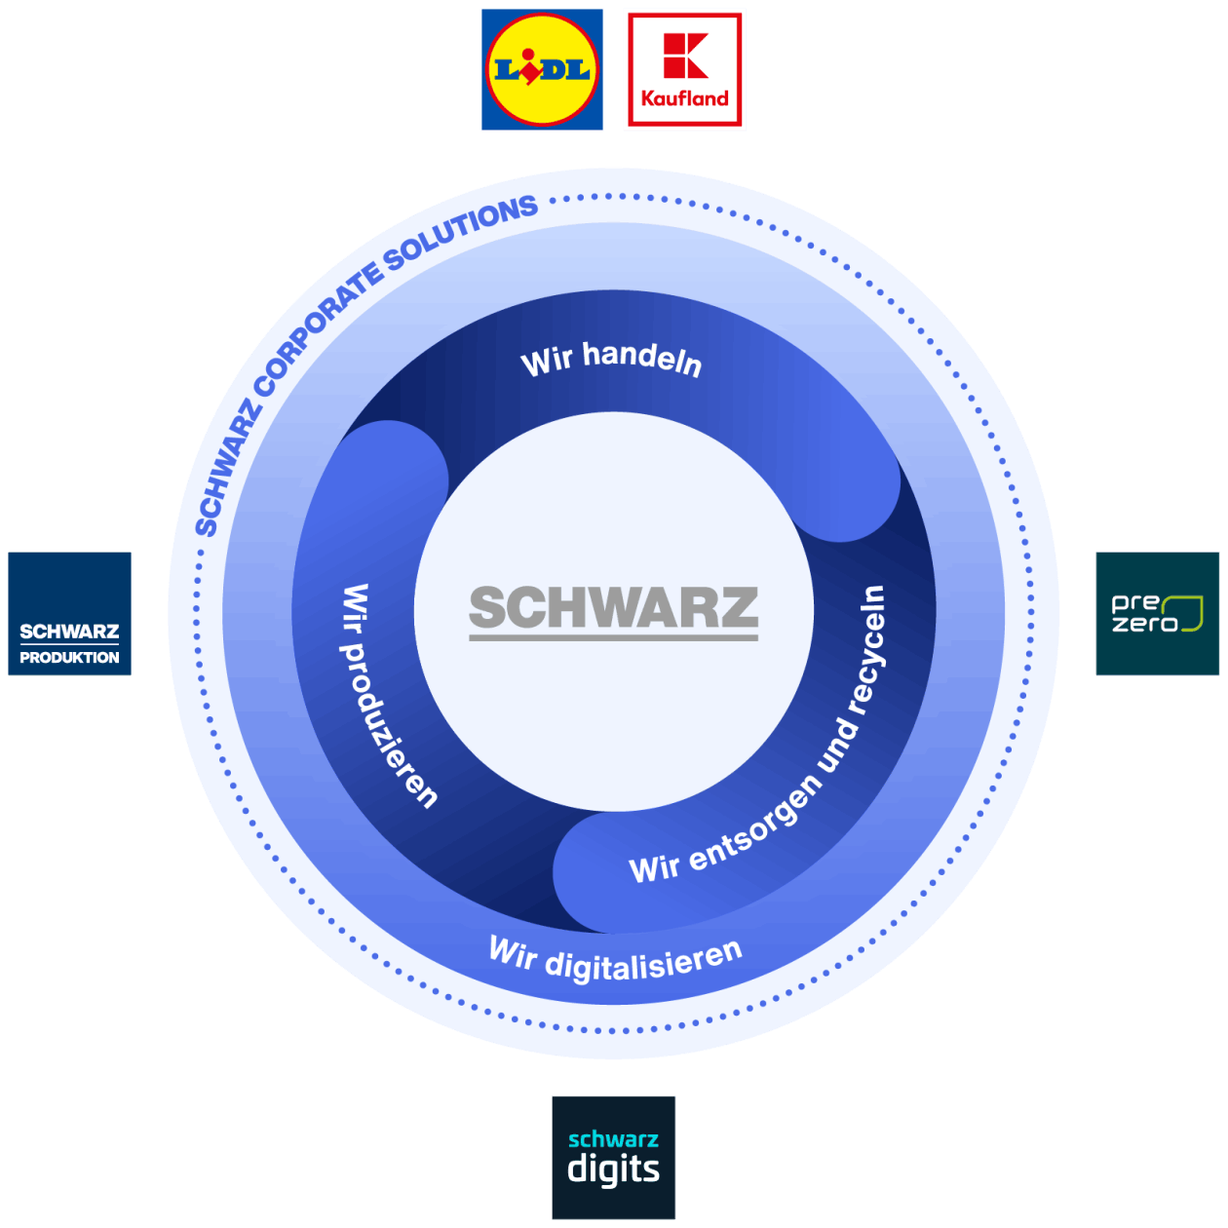
Schwarz Eco-system
STRATEGIC FIT
Where does Schwarz Gesundheit fit?
Notes:
ADAM

Slide 21
Schwarz Eco-system
STRATEGIC FIT
Where does Schwarz Gesundheit fit?
Notes:
ADAM

Slide 22
Where to start: impact vs. feasibility
PRIORITISATION
↑ Impact on customers and Schwarz
Phase 1 · 0–12 months
11
QUICK WINS
1 Meal planner and smart list
2 Healthy Deals and nudges
10
1
3 Bet on yourself
3
4 Self-service health stations
6
8 Move with Lidl
4
9
2
BIG BETS
Phase 2 · 1–3 years
5
5 Future You avatar
7
6 Health Line
8
7 Healthy Hour
9 FoodMatch
Phase 3 · 3–5+ years
LATER
EASY ADD-ONS
10 Lidl Life Exchange
11 Schwarz Gesundheit hub
Feasibility with existing Schwarz assets →
Notes:
We mapped every initiative by impact and by how feasible it is with assets Schwarz already has. Top right are the quick wins we launch first: the meal planner and smart list, Healthy Deals, Bet on yourself, health stations and Move with Lidl. Phase two adds Future You, Health Line, Healthy Hour and FoodMatch. The big bets, Life Exchange and the full Schwarz Gesundheit hub, need insurer partnerships and come last, built on the data and trust from phases one and two. Positions are our team’s estimate.

Slide 23
From loyalty driver to new revenue
BUSINESS LOGIC
HORIZON 3 · 3–5+ YEARS
HORIZON 2 · 1–3 YEARS
Health business
HORIZON 1 · 0–12 MONTHS
Partner revenue
Outcome-based contracts with insurers
Schwarz Gesundheit membership
Health services in every hub
Loyalty driver
Insurers co-fund rewards and credits
Paid check-ups at health stations
Municipal and employer partnerships
More visits and bigger baskets
Shift to fresh and own-brand products
Retail media from healthy brands
KPIs: visit frequency · fresh and own-brand share · active LidlHealth users · insurer partners · health outcomes
Notes:
The business model grows in three horizons. First, health is a loyalty driver: more visits, bigger baskets, a shift to fresh and own-brand products, and retail media from healthy brands. Second, partners pay: insurers co-fund rewards, check-ups at health stations are paid for, and municipalities and employers join. Third, Schwarz Gesundheit becomes a health business with outcome-based insurer contracts and a membership. We track visit frequency, product mix, active users, partners and health outcomes.

Slide 24
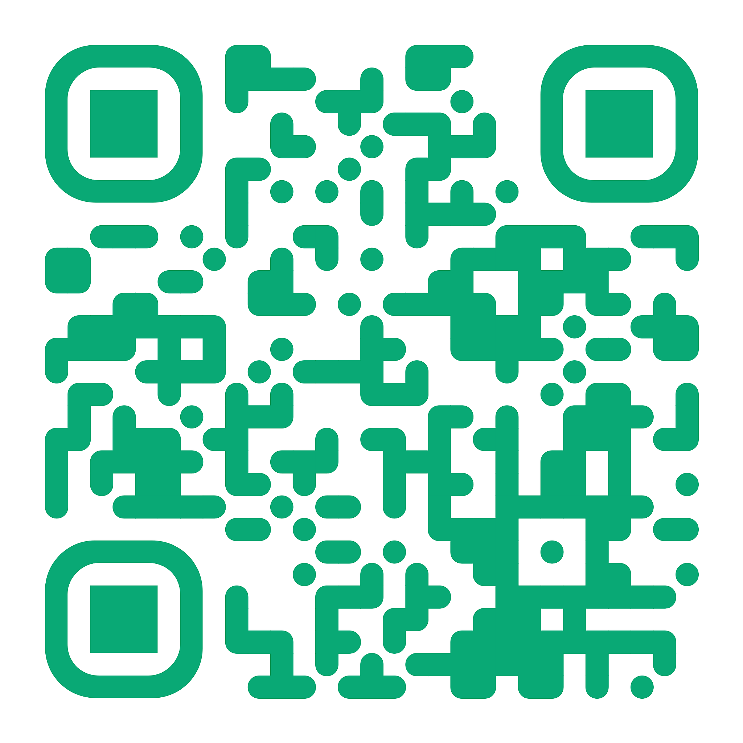
Today a supermarket sells you food.
Tomorrow it helps you live well.
SCHWARZ GESUNDHEIT
LidlHealth app
Community health hubs
Schwarz Gesundheit
Thank you. We look forward to your questions.
Notes:
To sum up: today a supermarket sells you food. With Schwarz Gesundheit, it helps you live well, starting tomorrow with the app and in-store hubs and growing into Europe’s most accessible health network. Thank you.

Slide 25
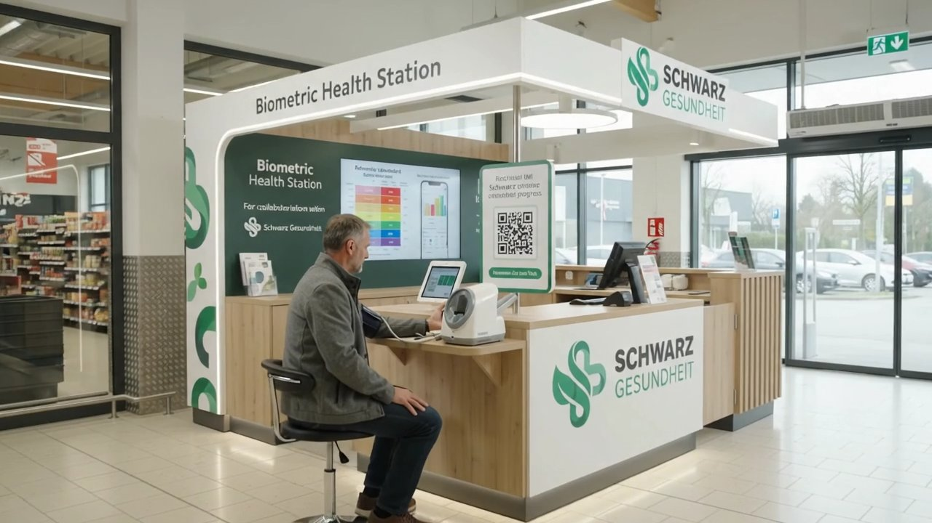

Slide 26
